Slide 1

Bringo Mobile Application
Final project
Madalina Buruiana

Slide 2
APPLICATION DESCRIPTION
Mobile application Version 3.0.0.50
Operator of personal shopping delivery platform designed to offer store products to the doorstep

Slide 3

Testing approaches
Dynamic and heuristic approaches
such as exploratory testing (more reactive approach than pre-planned approach)
Methodical Testing approach
Failure based (error guessing), Experience-based
Check-list based and quality characteristic-based (UI testing – Checklist )

Slide 4
Testing activities
Test planning :
Scope of testing -> finding the maximum number of
bugs
Where(testing env) -> Android 13
When -> 1.03.2023 – 15.03.2023
Test analysis and design
Create data using testing techniques
(Boundary Value Analysis /Equivalence Class Partitioning)
Create, review, update the test cases
Set the environment
Test execution :
Run the tests
Report the bugs
Test report :
Create the test deliverables
Test closure :
Lessons learned
Retrospective of the testing activities

Slide 5
Testing types
Ad-hoc testing to decide whether the application is worth further testing
Smoke testing for the main functionalities (Account, Cart, Orders, Search)
Exploratory testing to cover all the possible test scenarios for each functionality

Slide 6
Testing types
Functional testing
Positive/Negative testing
UI testing
Localization testing
Network testing
Connectivity testing

Slide 7

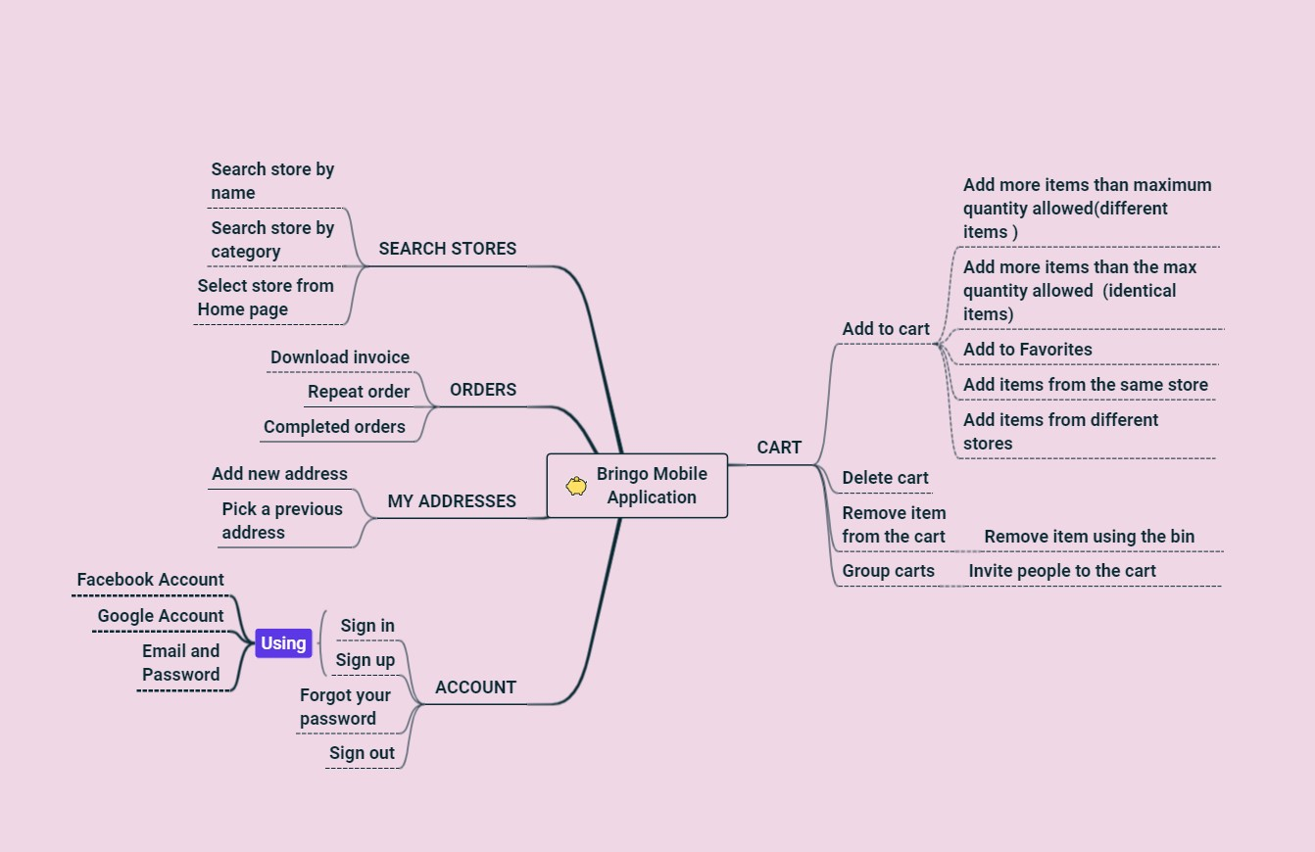
Test cases overview

Slide 8
Test cases results
FUNCTIONALITY | TOTAL | PASSED | FAILED | BLOCKED | NOT RUN | DEFECTS
ACCOUNT | 23 | 19 | 4 | 0 | 0 | 49099 49100 49101 49161
CART | 16 | 13 | 3 | 0 | 0 | 49104 49105 49107
ORDERS | 4 | 3 | 1 | 0 | 0 | 49109
SEARCH | 5 | 5 | 0 | 0 | 0
MY ADDRESSES | 6 | 5 | 1 | 0 | 0 | 49138
UI | 39 | 27 | 12 |  |  | 49217 49167 49160 49218 49163 49219 49220 49153 49158 49155 49152
LOCALIZATION | 4 | 0 | 4 | 0 | 0
NETWORK | 3 | 3 | 0 | 0 | 0
CONNECTIVITY | 5 | 2 | 3 | 0 | 0 | 49222 49223 49225
OVERALL RESULTS | 105 | 77 | 28 | 0 | 0 | 28
PERCENTAGE | 100% | 73.33% | 26.66% | 0% | 0%

Slide 9
Bugs overview
MAJOR 36% | NORMAL 46% | MINOR 18%
ACCOUNT FUNCTIONALITY | ACCOUNT FUNCTIONALITY | ACCOUNT FUNCTIONALITY
CART FUNCTIONALITY | ORDERS FUNCTIONALITY | UI ( User interface)
 | CART FUNCTIONALITY

Slide 10
Tools used
Mantis Bug Tracker – Bug Reporting
Xmind Tool – Mind Maps
Snip&Sketch – Screenshots Capture
Screenpresso – Screenshots Capture
Microsoft Office Package
Excel - Test Cases
Power Point – Final project presentation
Word – Test Report

Slide 11
Conclusions
The objective of the actual project was to find the maximum number of bugs
Test effort was measured in hours spent -> 90h
During Smoke testing 3 bugs were found
During Exploratory 25 bugs were found
Data type used during testing : Blank, Valid, Invalid, Big Data

Slide 12
Lessons learned
CHALLENGES :
The main challenge was to find bugs for an application already in production
The lack of requirements was also a challenge, therefore the testing was based on user’s experience
Another challenge was to put in practice theoretical concepts studied during the training taken from the Informal School of IT
LESSONS :
Take small steps at the beginning
Attention to details has improved during the testing
UI testing is a complex process

